Slide 1
TrafficTelligence
Advanced Traffic Volume Estimation with Machine Learning
Baichigeri Manasa
Akula Shivathmika
G Jayanthi
D Poojitha

Slide 2

Abstract
TrafficTelligence is a machine learning-based traffic volume prediction system that helps city planners optimize traffic flow using historical data, weather patterns, and events.

Slide 3
Problem Statement
Urban congestion causes delays, fuel waste, and pollution. Traditional traffic systems lack prediction capabilities.

Slide 4
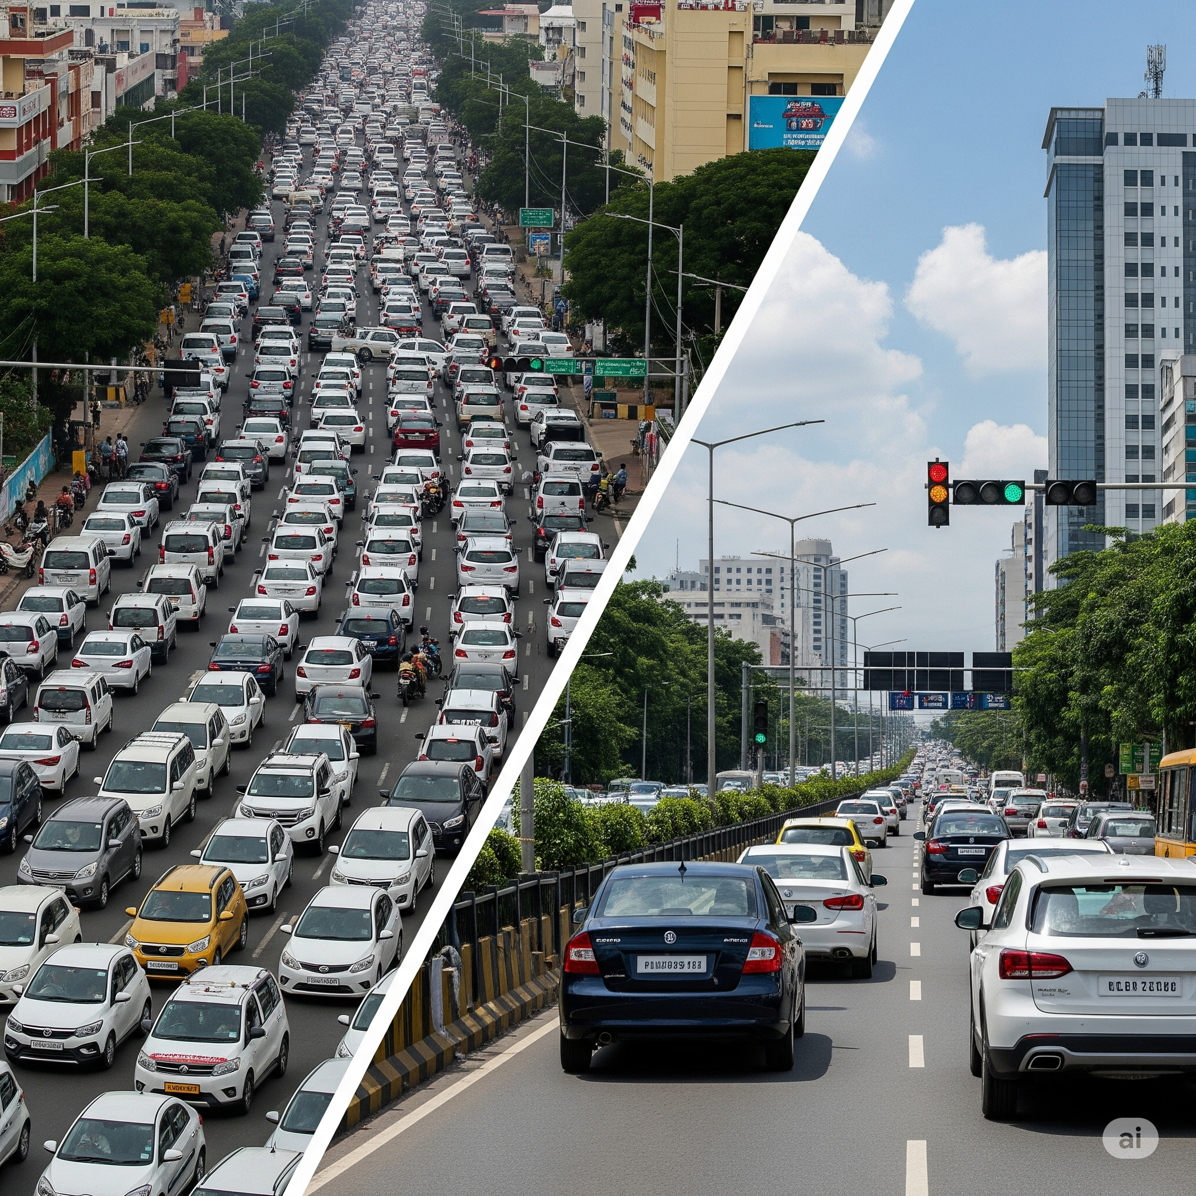
Objective
- Predict traffic volume using ML
- Real-time traffic control
- Improve commuter experience
- Smart planning

Slide 5
Dataset Used
- Metro Interstate Traffic Volume
- Attributes: Date, time, weather, holidays, volume
- 48,000+ records

Slide 6

Tools & Technologies
- Python, Pandas, NumPy
- Matplotlib, Seaborn
- Scikit-learn, Power BI

Slide 7
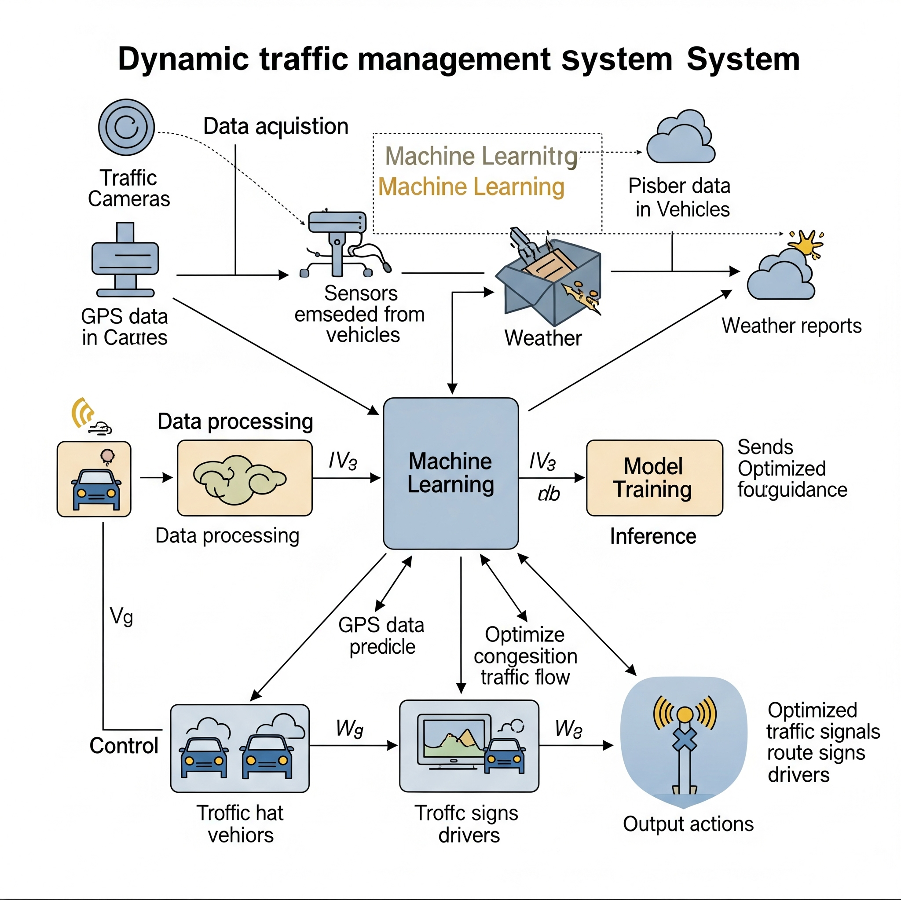
Methodology
1. Collect data
2. Clean and preprocess
3. Feature engineering
4. Model training
5. Evaluation
6. Visualization

Slide 8
Scenario – Dynamic Traffic Management
- Smart signals
- Congestion prediction
- Emergency lane suggestions
- Data sharing with apps

Slide 9
Algorithms Used
- Linear Regression
- Decision Tree
- Random Forest (Best performer due to ensemble learning)

Slide 10
Results & Accuracy
- R² Score: 0.87 (Random Forest)
- Low RMSE
- Robust across weather/time variations

Slide 11
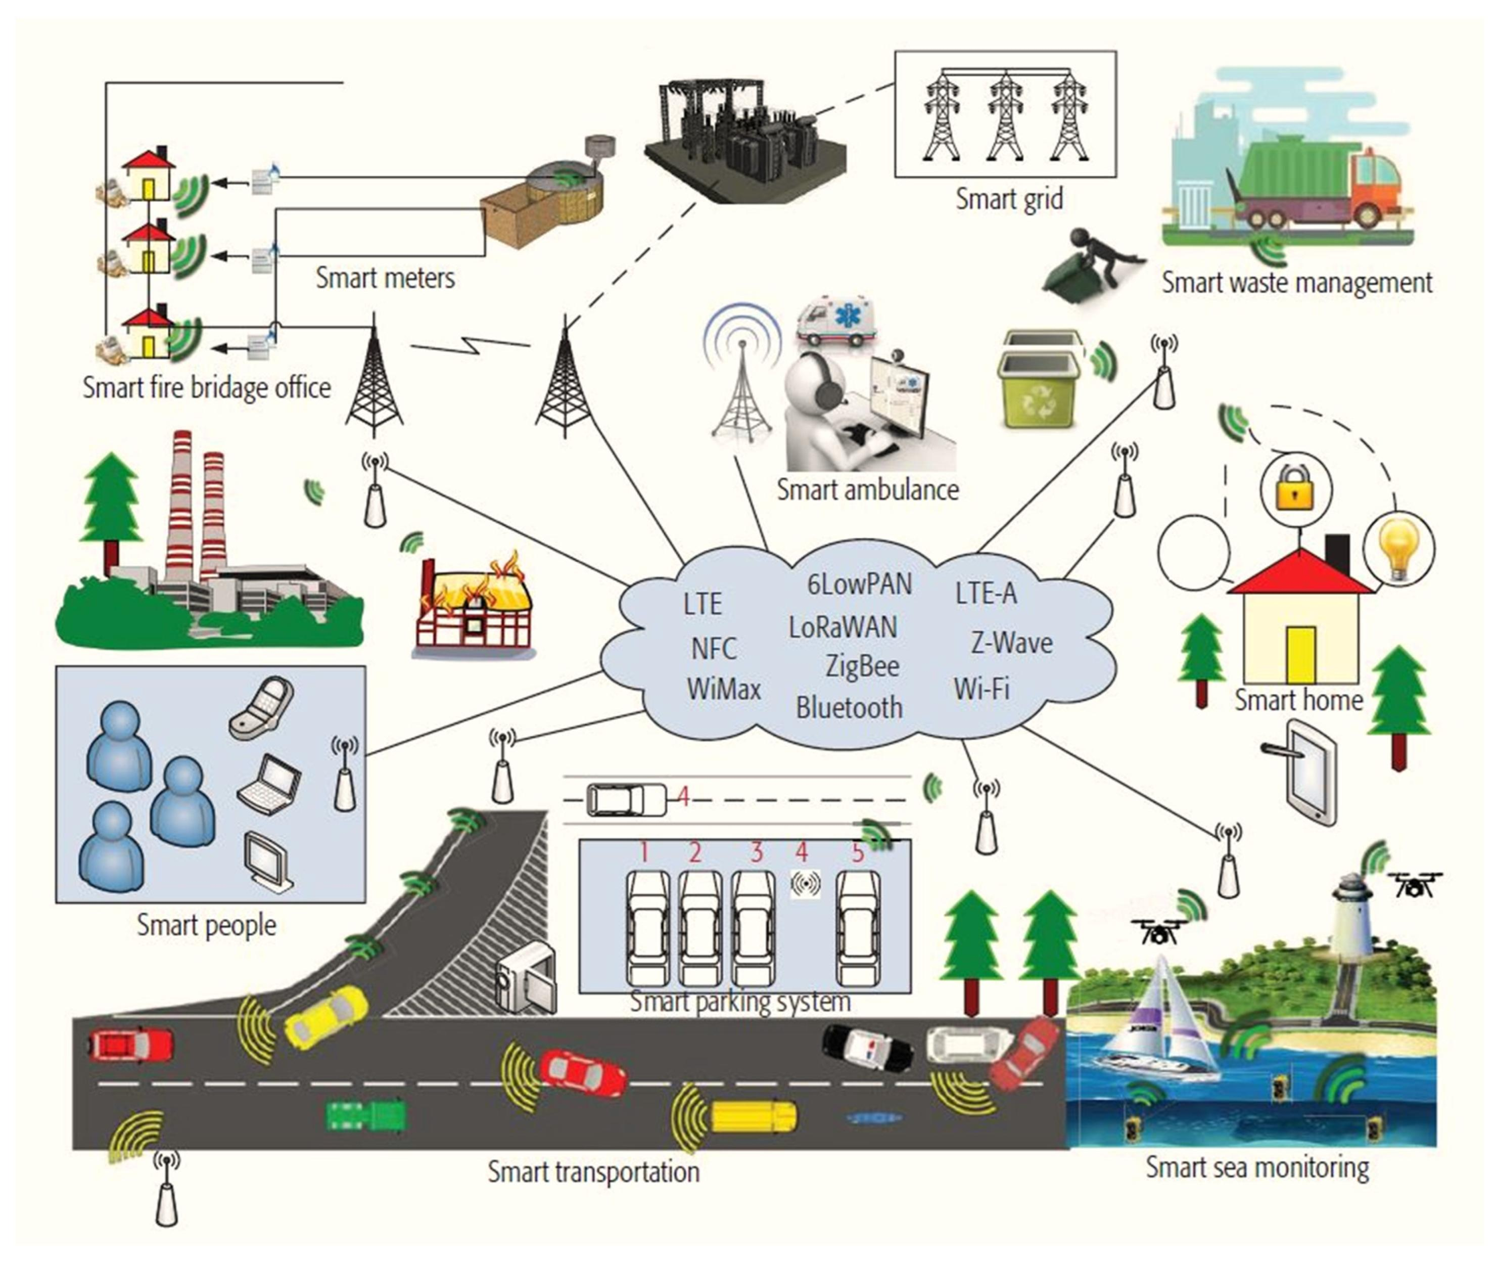
Future Scope
- IoT integration
- Real-time dashboards
- City-wide expansion
- Deep learning applications

Slide 12

Conclusion
TrafficTelligence shows how ML improves traffic systems. Predictions reduce congestion and help commuters.

Slide 13
